Slide 1
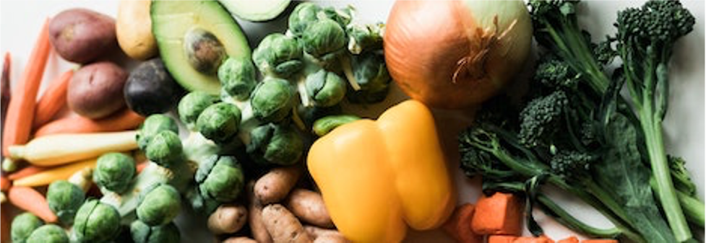
Delivering to Washington DC Food Deserts
Photo by Nathan Dumlao on Unsplash
Alison Garrett
Unsolicited Proposal to 4P Foods
15 October 2021

Slide 2
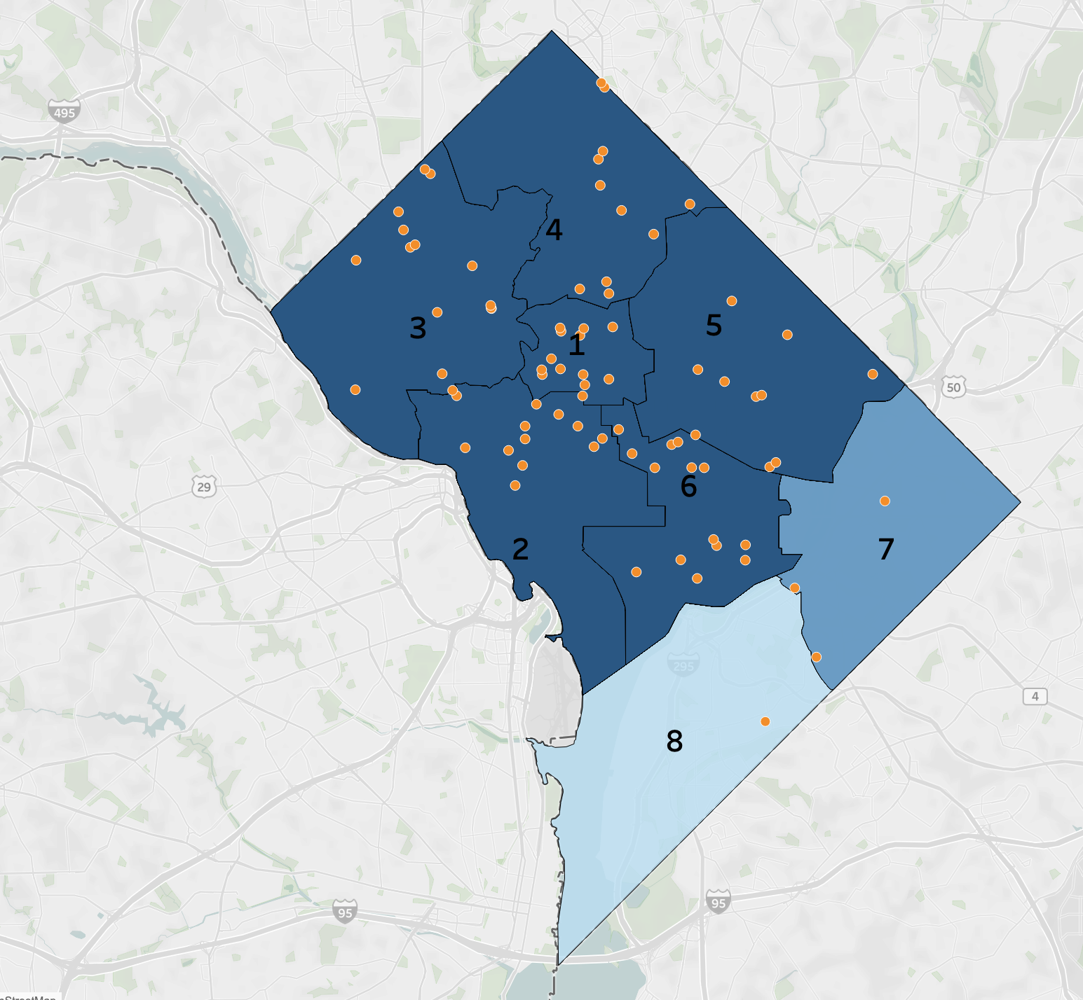
Introduction
Washington DC, particularly Wards 7 and 8, suffer from Food Deserts
Residential areas greater than 1600m (~1 mile) from fresh, good quality food
Low incomes affect transportation including private automobiles and public options
COVID-19 further limits near term access to more conventional food distribution choices
Washington DC
Washington DC
Unofficial community solutions … might already exist and just needs to be formalized and scaled.
DC Hunger Solutions¹
Grocery Stores

Slide 3
4P Foods
Fortunately, there are companies like 4P Foods, a start-up with a new model of agriculture and a mission to,
Eat Good Food
Change the World
4P Foods²
4P Foods supports local farmers while ensuring the community has equitable access to the food they produce
What if 4P Foods could help eliminate the Washington DC Food Deserts while growing its mission?
4P - Purpose People Planet Prosperity

Slide 4
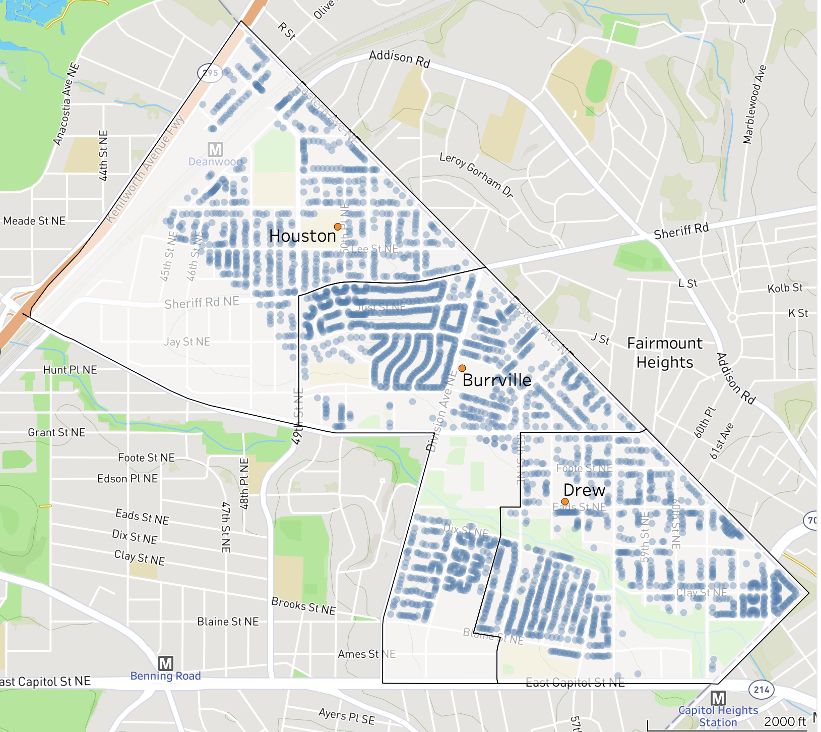

Serving the Community
Ward 7: Deanwood, Burrville, Grant Park, Lincoln Heights, Fairmont Heights
Houston
Burrville
Drew

Slide 5
Serving the Community
Ward 7: Deanwood, Burrville, Grant Park, Lincoln Heights, Fairmont Heights
Population of 11,944 of which 25% are children
Averaging 2.3 people per household
16% households without vehicle
13% households use SNAP
Existing Wednesday delivery route adding three elementary schools: Burrville, Drew, Houston
Houston
Burrville
Drew

Slide 6
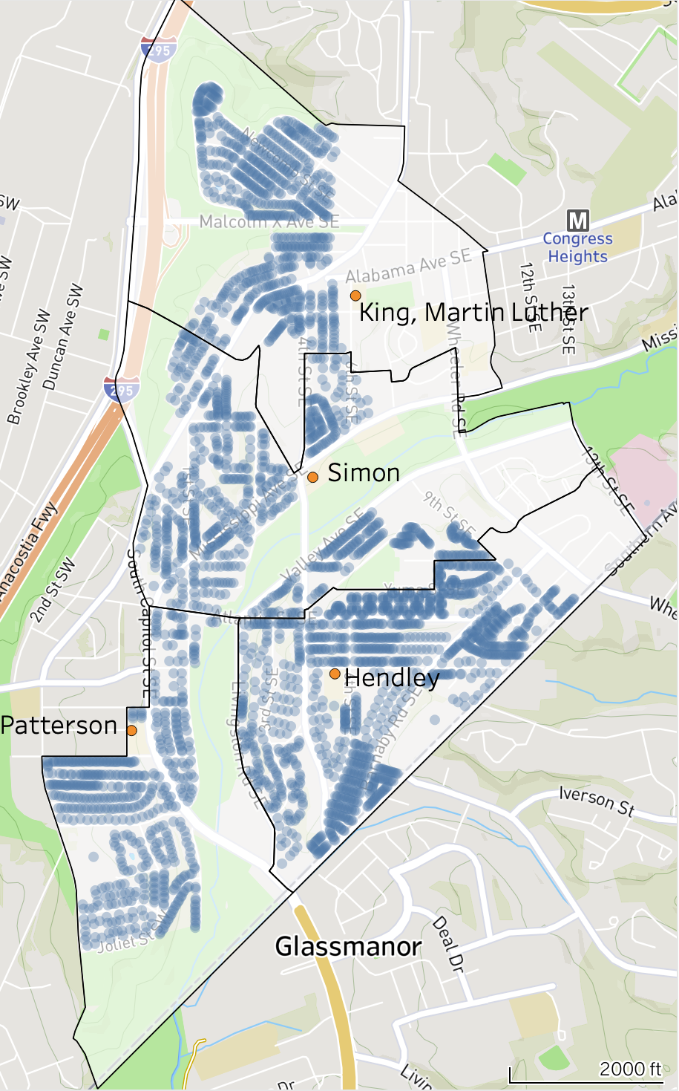
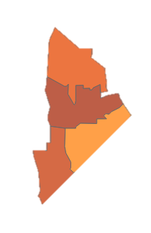
Serving the Community
Ward 8: Bellevue, Congress Heights, Washington Highlands
Martin Luther King
Simon
Hendley
Patterson

Slide 7
Serving the Community
Ward 8: Bellevue, Congress Heights, Washington Highlands
Population of 25,332 of which 27% are children
Averaging 2.1 people per household
19% households without vehicle
16% households use SNAP
Existing Wednesday delivery route adding three elementary schools: Hendley, King, Patterson, Simon
Martin Luther King
Simon
Hendley
Patterson

Slide 8
4P Foods Business Return
Assume 1% of the population of 37,276 purchases fresh, good quality groceries
Select small bags which feed 2 people at $73 weekly
At $316 monthly this is affordable per SNAP at $459 for a family of 2³
Annual Revenue: $1.4M

Slide 9
Recommendations
Assess Maryland grocery store locations to fulfil the need and adjust
Partner with DC Hunger Solutions on a Ward 7 – Cluster 31 and Ward 8 – Cluster 39 pilot
Design of 4P Bags aligning with menus, SNAP requirements and family size
Strategy for ordering / payment to include SNAP
Optimization of delivery schedule and times
Community engagement and outreach
Consider a phased approach, beginning with a walk up delivery truck to mitigate risk

Slide 10
Backup

Slide 11
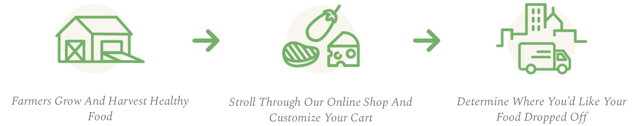
Approach
Continue to support Produce, Dairy, and Meat farmers in producing fresh, good quality local food
Provide Small / Medium / Large 4P Bags, aligning with SNAP requirements and family size
Deliver to neighborhoods with Elementary School pick-up, using existing routes to limit fees

Slide 12
Algorithms
USDA CSA Directory
DC Open Data PS Attendance Areas
DC Open Data Public Schools
4P Selection
Delivery Areas
Elementary School
Pilot
Program
Plan
DC Open Data Address Points
Ward 7 and 8
Residential
Grocery Stores
Access
Demographics
DC Open Data Farmers Market Locations
USDA Food Access Research Atlas
DC Open Data 2020 Census Data
DC Open Data Grocery Store Locations
2010 to 2020 Census Tract Crosswalk
Tabular
Shapefile
Both

Slide 13
References
DC Hunger Solutions, Still Minding the Grocery Gap in DC: 10th Anniversary Grocery Store Report
4P Foods, Eat Good Food, Change the World: People, Planet, Prosperity, Purpose are the four P’s of 4P Foods
DC SNAP Benefits
DC Open Data Address Points
DC Open Data 2020 Census Data
DC Open Data Public Schools and Public School Attendance Areas
DC Open Data Farmers Market Locations
DC Open Data Grocery Store Locations
USDA Food Access Research Atlas and 2010 to 2020 Census Tract Crosswalk
USDA Community Supported Agriculture Directory

